Slide 1
Cybersecurity Threat Landscape
Mark Ward (SVP, Chief Information Security Officer)
May 1, 2025

Slide 2
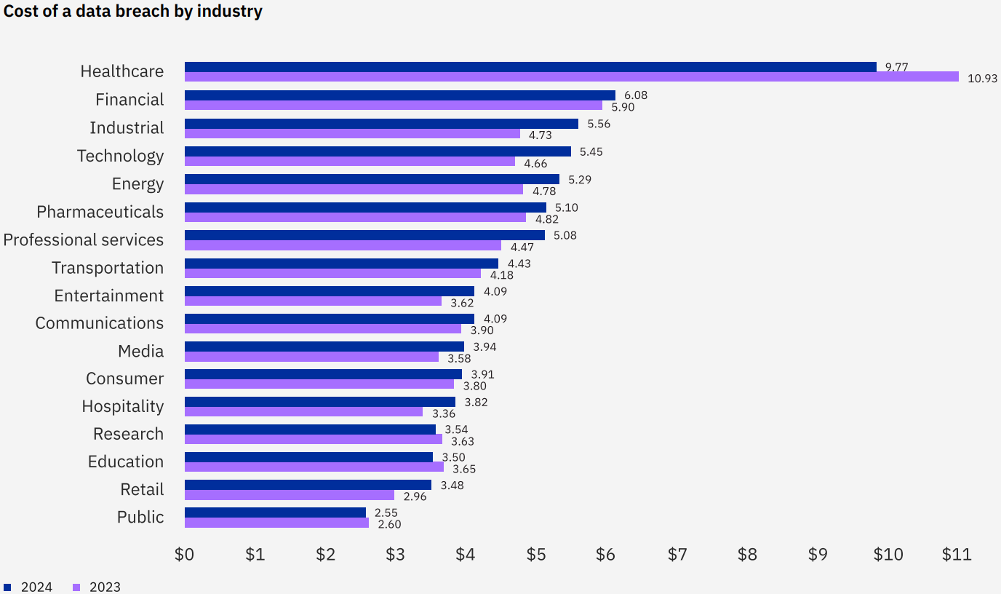
Cost of a Data Breach
Cost increased 9.7% from $4.45M in 2023 to $4.88M in 2024
Breach related financial impacts…
Lost Business (~39%): Lost revenue, customer churn, downtime, reputational damage, and SLA penalties
Detection & Escalation (~28%): Time and effort to detect, triage, investigate, and forensics to confirm the breach.
Post-Breach Response (~27%): Legal fees, regulatory fines, PR/Crises communication, customer notification, credit monitoring
Notification (~6%): Creation and delivery of breach notifications to regulators, customers, and partners.
Millions

Slide 3
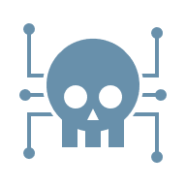
Cyber Attack volume, quality, and speed are increasing!
Throughout 2024 into 2025, 50,000+ reported cybersecurity incidents with almost 23,000 confirmed data breaches.
The time the attacker requires to move from the initial point of compromise to other assets on company networks, aka ‘breakout time’, is now down to an average of 48 minutes with the fastest reported at 51 seconds!
Every month even SMB’s have billions of logged events, correlating to thousands of incidents to be analyzed, with tens or hundreds of true-positive incidents to contain and respond to 24x7x365!
Ransomware as a Service (RaaS) has lowered the bar to less sophisticated attackers getting in the game increasing the overall volume of ransomware attacks.
Ransomware is present in 44% of global breaches, 70% of small business breaches and over 90% of mid-sized business breaches.
Cybersecurity defenders need to be right 100% of the time, the attackers only need to be right once!
Cyber threat detection and response is no longer a human scale problem!

Slide 4

Vulns & Weak Configurations
There were 40,000+ vulnerabilities published in 2024.
13.7% (5,481) classified as ‘Critical’.
A substantial number of these critical vulns allowed unauthenticated remote code execution (RCE).
AI tools help attackers quickly and accurately build exploit code for newly announced vulnerabilities.
Infostealer malware surged in 2024 exploiting system vulnerabilities stealing over 2.1 billion credentials accounting for more than 60% of all credentials stolen last year.
Over 30% of all breaches were the result of attackers exploiting vulnerabilities and poorly configured (weak) systems because of ‘human error’.

Slide 5
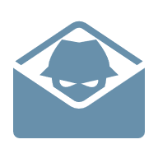
Email Security
Most attacks still start with socially engineering people with phishing, smishing (fake SMS texts), and vishing (fake voice calls).
442% increase in AI assisted vishing (fake phone call) attacks in the last year which are often correlated to support the success of phishing and smishing attacks.
BEC (Business Email Compromise) increased nearly 250% year over year, now makes up approximately 8.5% of all data breaches, are more targeted than typical phishing often asking for sensitive information or transferring funds by impersonating trusted individuals or organizations and cost companies an average of $4.67 million per attack.
Over 90% of global email traffic is categorized as spam, encompassing unsolicited, unwanted, or malicious content.

Slide 6
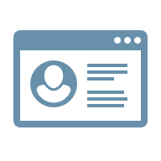
Credential Abuse & Theft
The initial access of many attacks are malware-free often involving stolen credentials.
Increased risks from accessing company systems from unmanaged assets, impacting digital identity security.
Smishing (fake SMS texts) attacks have increased significantly, bypass traditional email security and deceive victims into revealing credentials.
Weak or reused compromised passwords are a major factor in credential abuse and theft.
Most annual cybersecurity reports have credential theft and abuse as a leading or top 3 attack vector.

Slide 7
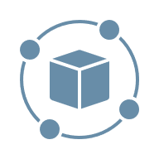
3rd Party Supply Chain
Exploitation of vulnerabilities within third-party supply chains now accounts for about 30% of breaches making it a high cybersecurity risk.
Unmanaged data sources in third-party environments are increasing the complexity and cost of breaches.
Vulnerabilities in third-party software and cloud services increasingly being used for initial access, data theft, and lateral movement into customer networks.
30% of breaches involved third parties, doubling from the previous year.

Slide 8
Don’t be the easy to get, ‘Low Hanging Fruit’!
Patch and update systems within 30-day cycles to reduce your attack surface. Some critical vulnerabilities allow Remote Code Execution (RCE) without authentication!
Enforce Multi-Factor-Authentication (MFA) everywhere (especially with privileged accounts!). Someone in your company will eventually fall for a social engineering attack. Don’t let weak and reused compromised passwords to be your downfall.
Start from hardened secure configurations like CIS Benchmarks for your internally managed and cloud-based builds. Don’t let limited in-house cybersecurity capabilities and human error open your company to attacks.
Maintain regular backups, daily and ‘immutable’, and test recovery regularly. You will eventually need them!
Deploy the best Email Security, EDR (Endpoint Detection & Response), and Managed Security Operations Services you can afford! Detecting, analyzing, containing, and responding to cyber threats requires qualified people watching 24x7x365 using automation and AI assisted analysis to keep up with AI assisted and automated attacks. Don’t be an easy low-cost target, and the next headline.
Monitor your third-party supply chain, and yourself, with scoring services (BlackKite, SecurityScorecard, BitSight, others) to quickly find and remediate the weakest link in your chain.

Slide 9


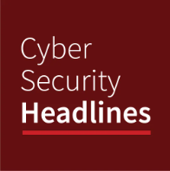
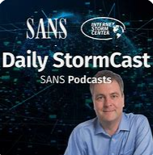


Other Helpful Resources to Consider…
Control Frameworks
  CIS Critical Controls: Prioritized controls with clear language mapped to other compliance frameworks, built on best practice cyber threat models like MITRE ATT&CK offering many free resources. (https://www.cisecurity.org/controls)
  NIST Small Business Cybersecurity Corner: Cybersecurity basics for small businesses with free resources. (https://www.nist.gov/itl/smallbusinesscyber)
Free Daily Cyber Threat Intelligence Podcasts (~15min; ~7min each)
  Cyber Security Headlines (https://cisoseries.com/category/podcast/cyber-security-headlines/)
  SANS Internet Storm Center (https://isc.sans.edu/podcast.html)
Free Security Scores:
  Even if you don’t have budget for a cybersecurity scoring services like BlackKite, SecurityScorecard, or BitSight to monitor you and your critical third-party supply chain vendors, check out their sites for a FREE report on your company’s domain.

Slide 10
Sources
If you would like to do a deeper dive into the data…
Verizon 2025 Data Breach Investigation Report (18th edition)
Crowdstrike 2025 Global Threat Report (9th edition)
ReliaQuest 2025 Annual Cyber-Threat Report (7th edition)
Mandiant M-Trends 2025 (16th edition)
IBM/Ponemon Cost of a Data Breach Report 2024 (19th edition)
Sophos Annual Threat Report "Cybercrime on Main Street 2025 (12th edition)

Slide 11
Mark Ward
SVP, Chief Information Security Officer
Johnson Financial Group
Notes:
Closing Message Text= Font: Lato, Color: White, Size: 24 pt, Spacing: 18 pt before and 0 pt after, Line Spacing: Exactly at 22 pt

Slide 12
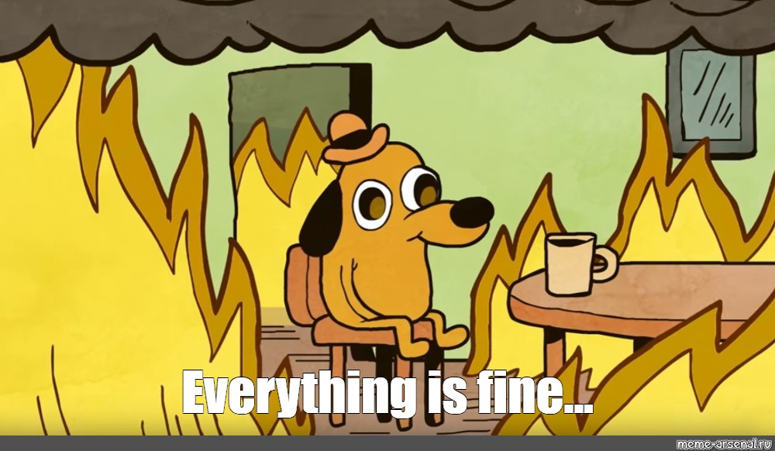
Responding to a Ransomware Event
Immediate IT Response
Isolate affected systems by restricting external network traffic to prevent further damage:
Reset admin passwords
Check firewall for active suspicious connections
Do not start wiping systems!
Pause scheduled maintenance tasks that overwrite logs or overwrite backups
Removing network cables
Secure and validate backups
Network contain systems in EDR
Disable virtual network connections

Slide 13
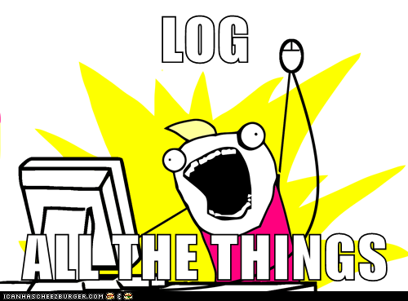
Evidence to collect
Ransom note and sample encrypted files
EDR and live response data
Firewall and VPN logs
Endpoint triage data
Forensic images/virtual disks
Cloud logs/email logs
Web filter logs
Application logs
Employee interview
Netflow logs

Slide 14
Evidence Preservation
Image/collect artifacts from key servers
Domain Controllers
Terminal Servers
File Servers (operating system drives)
Servers that contain sensitive info
For virtual servers collect the VMDK or VHD files along with the associated files contained in the VM folder.
Systems that do not show signs of encryption are often used as staging points; do not assume they were not accessed.
Note:

Slide 15
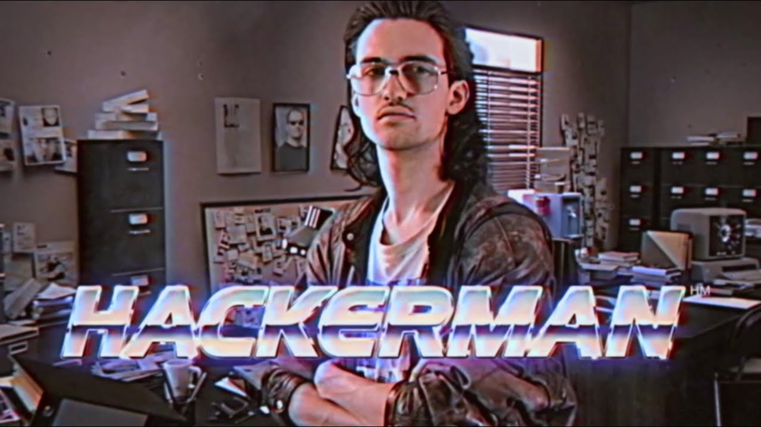
Investigate
Patient 0 / Entry Point
Privilege Escalation
Persistence
Lateral Movement
Data Access/Exfiltration
Encryption
Goal (Extortion for Ransom)

Slide 16
Why Communicate With Threat Actor?
Prevent/Delay Harassment
Prevent/Delay Posting
Obtain List of Exfiltrated Files
Confirm Data Exfil
Proof of Life

Slide 17
Communication Methodology
Collect Note
.txt file dropped on system
File extension
Extortion emails
Blog announcement
Establish Contact
Chat panel
Gather Intel
Exfiltrated data list?
Encryption impact
Settle or Delay
Determine end goal
Delay tactics include holidays, weekends, proof exercises, leadership meetings.
Web form submission
Email
qTox
Telegram/Signal
Session
Demands
Get proof of data theft
Or purchase decryptor

Slide 18
Communication Methodology
Collect Note
.txt file dropped on system
File extension
Extortion emails
Blog announcement
Establish Contact
Chat panel
Gather Intel
Exfiltrated data list?
Encryption impact
Settle or Delay
Determine end goal
Delay tactics include holidays, weekends, proof exercises, leadership meetings.
Web form submission
Email
qTox
Telegram/Signal
Session
Demands
Get proof of data theft
Or purchase decryptor

